Slide 1
Data types

Slide 2
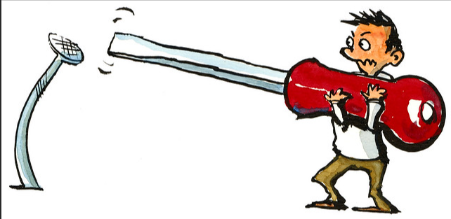
Why it matters

Slide 3

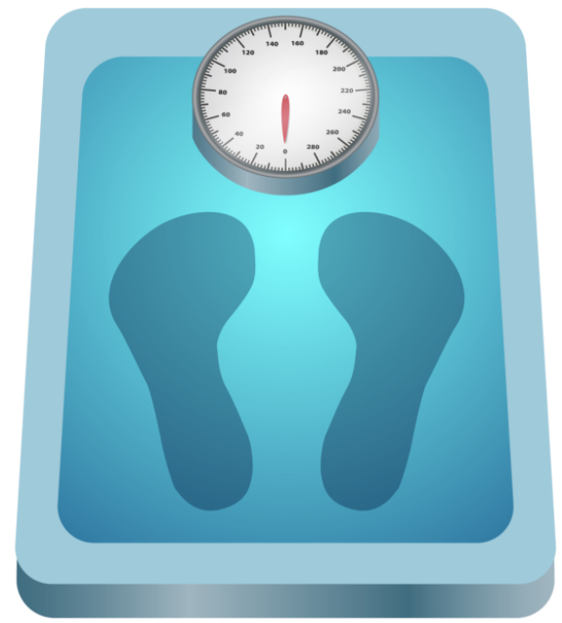
Continuous data
Data
Continuous data are measured on a continuous scale and can take any value within a specific range
  Weight
  Race time

Slide 4
Continuous data
Most common statistics
Continuous data are measured on a continuous scale and can take any value within a specific range
Most common statistics:
Mean
Difference in means
Median
Difference in medians

Slide 5
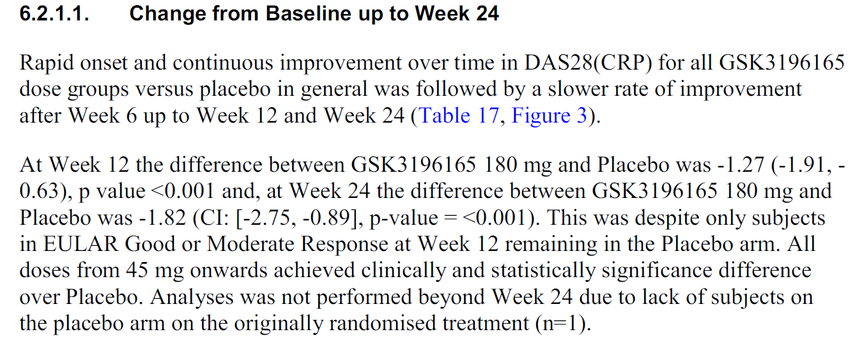
Continuous data
Putting it into practice: Otilimab Ph2 study in rheumatoid arthritis
Language to describe the results
Is it a difference in means or medians?

Slide 6
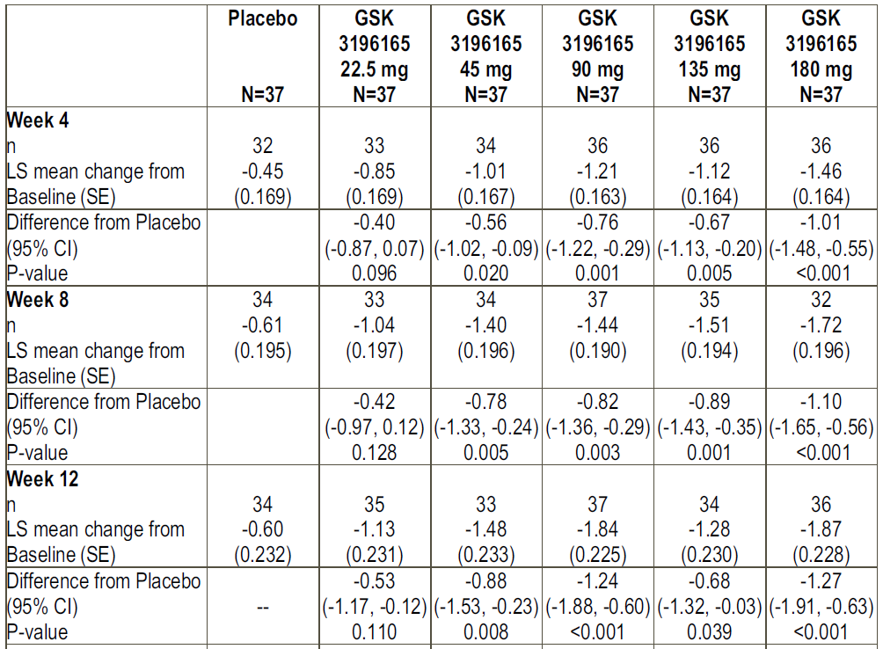
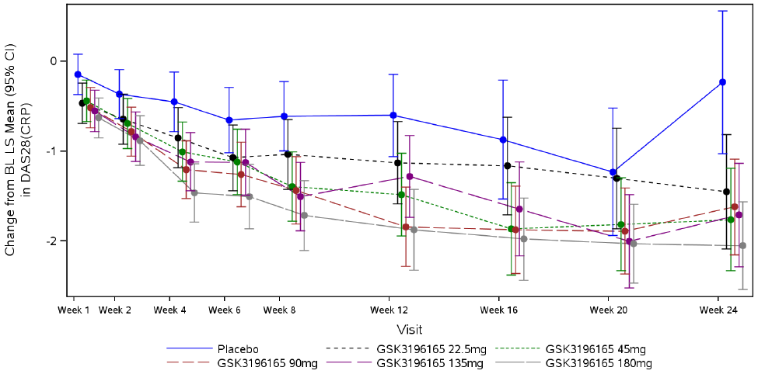
Continuous data
Putting it into practice: Otilimab Ph2 study in rheumatoid arthritis

Slide 7
Binary data
Data
Binary data has two options for response, e.g. “Yes” or “No”
  Death or AE occurrence
  Dichotomised continuous variable
    Responder/non-responder status
“Yes”
“No”

Slide 8
Binary data
Most common statistics
Binary data has two options for response, e.g. “Yes” or “No”
Most common statistics:
Risk
Absolute risk difference
Probability of a certain event occurring
Relative risk/risk ratio (RR)
Odds
Odds ratio (OR)
Ratio of the risk of event to the risk of no event

Slide 9
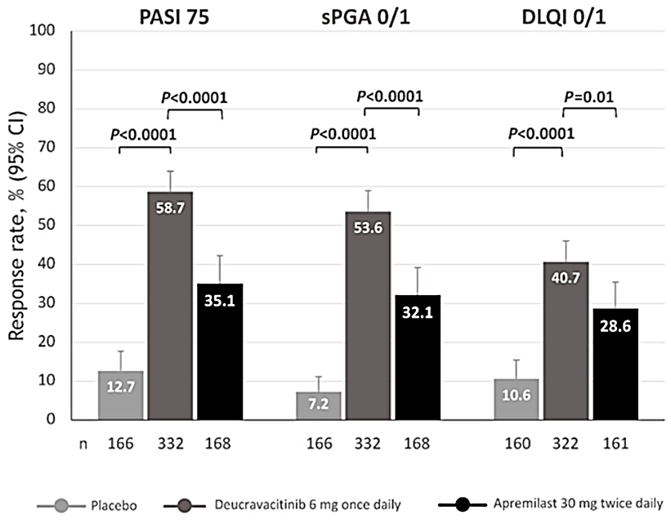
Binary data
Putting it into practice: Phase 3 study in psoriasis
What is presented in the figure?

Slide 10
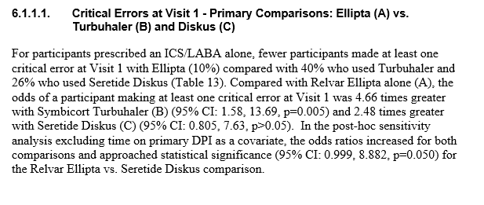
Binary data
Putting it into practice: Device study for ELLIPTA
Can you find the OR for (B) vs (A) comparison?

Slide 11
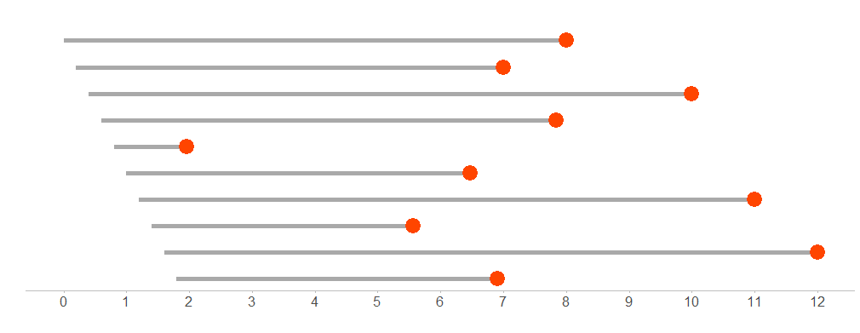
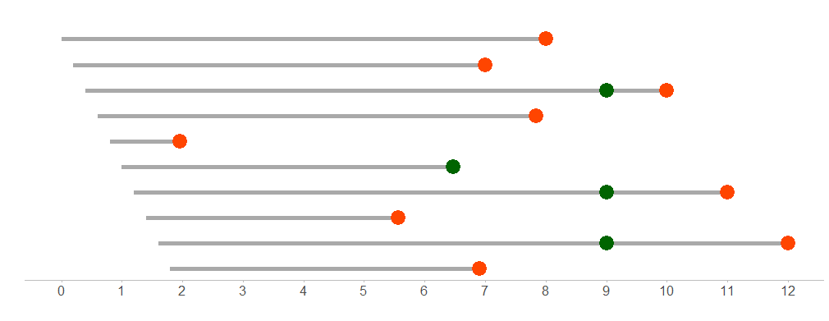
Time-to-First-Event Data
Data
Time-to-first-event endpoints are limited by trial length and events such as subject loss to follow up, so they are analysed differently
Example: Time to death (Overall Survival)
Subject 1
Death
Subject 2
Subject 3
Censor
Subject 4
Subject 5
Subject 6
Subject 7
Subject 8
Subject 9
Subject 10
Time on Study (Years)
End of trial

Slide 12
Time-to-First-Event Data
Most common statistics
Most common statistics:
Median survival time
Difference in medians
Risk (probability) of event
Difference in risks (probabilities)
Hazard
Hazard ratio (HR)
Instantaneous risk of the event
Kaplan-Meier curve

Slide 13
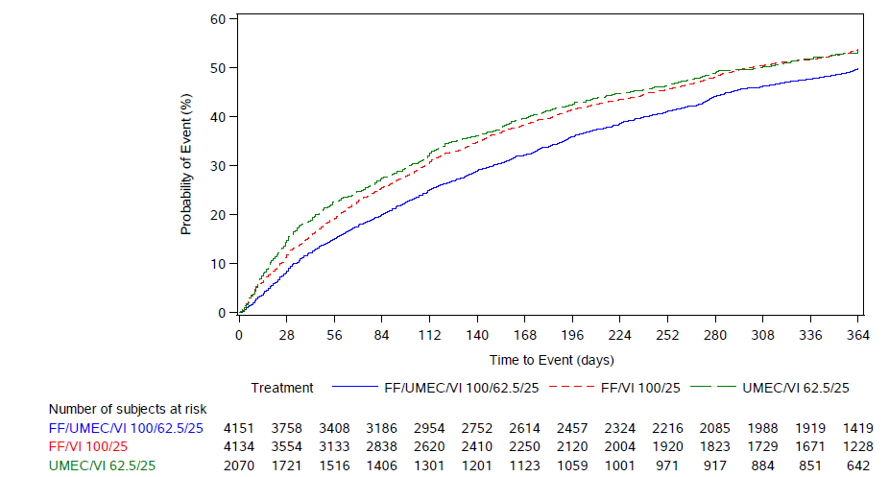
Time-to-First-Event Data
Putting it into practice: IMPACT Ph3 study in COPD
Median time to event for UMEC/VI 62.5/25

Slide 14
Time-to-First-Event Data
Putting it into practice: IMPACT Ph3 study in COPD
Median time to event
First quartile (25th percentile) time to event

Slide 15
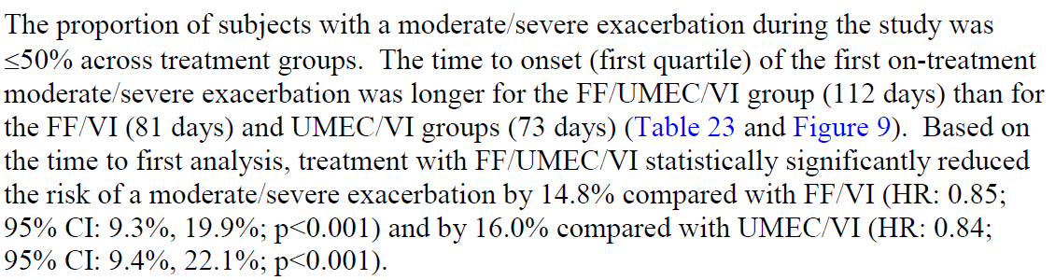

Time-to-First-Event Data
Putting it into practice: IMPACT Ph3 study in COPD
How to get % reduction from a ratio?
(1-0.85)*100 = 15%

Slide 16
Time-to-First-Event Data
Putting it into practice: IMPACT Ph3 study in COPD
Recurrent data

Slide 17
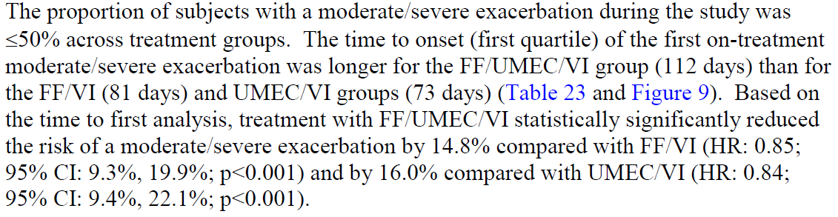
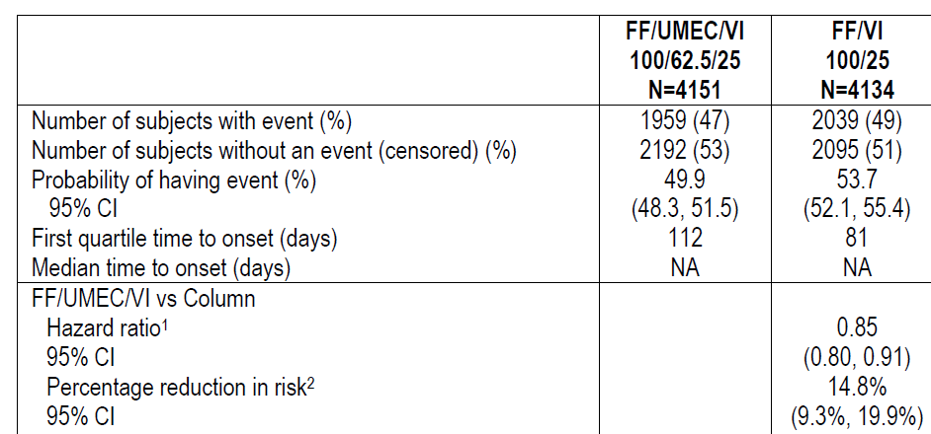
Time-to-First-Event Data
Putting it into practice: IMPACT Ph3 study in COPD

Slide 18
Recurrent Event Data
Data
The event can occur more than once; limited by trial length and events such as loss to follow up or withdrawal
Subject 1
Subject 2
Subject 3
0
6
12
18
Event
Time at risk from randomisation (months)

Slide 19
Recurrent Event Data
Most common statistics
The event can occur more than once; limited by trial length and events such as loss to follow up or withdrawal
Most common statistics:
Rate
Rate ratio
Frequency with which event occurs over a specified time period

Slide 20
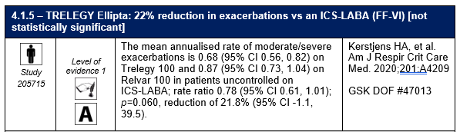
Recurrent Event Data
Putting it into practice: CAPTAIN Ph3 study in asthma
How to get % from a ratio?
(1-0.78)*100% = 22%

Slide 21
Key Messages
Data types and families
  Different data types require different statistics to summarise and compare data.
  Incorrectly used or interpreted statistics can lead to misleading conclusions.
  Any ratio could be expressed as a percentage.
What do you need to do?
  Be aware of the data type being summarised or compared.
  Pause to think if the right statistics are being used.

